Slide 1
Loss for image generation

Slide 2
Generating Images with Perceptual Similarity Metrics based on Deep Networks
NIPS 2016

Slide 3
Problems
Typically used squared Euclidean distance between images often yields blurry results. This is especially the case when there is inherent uncertainty in the prediction.
Feature representations are typically contractive, many images, including non-natural ones, get mapped to the same feature vector.

Slide 4
Insight
Invariance to irrelevant transformations and sensitivity to local image statistics can be achieved by measuring distances in a suitable feature space.
Using a distance in feature space alone, however, does not yet yield a good loss function: adversarial training

Slide 5
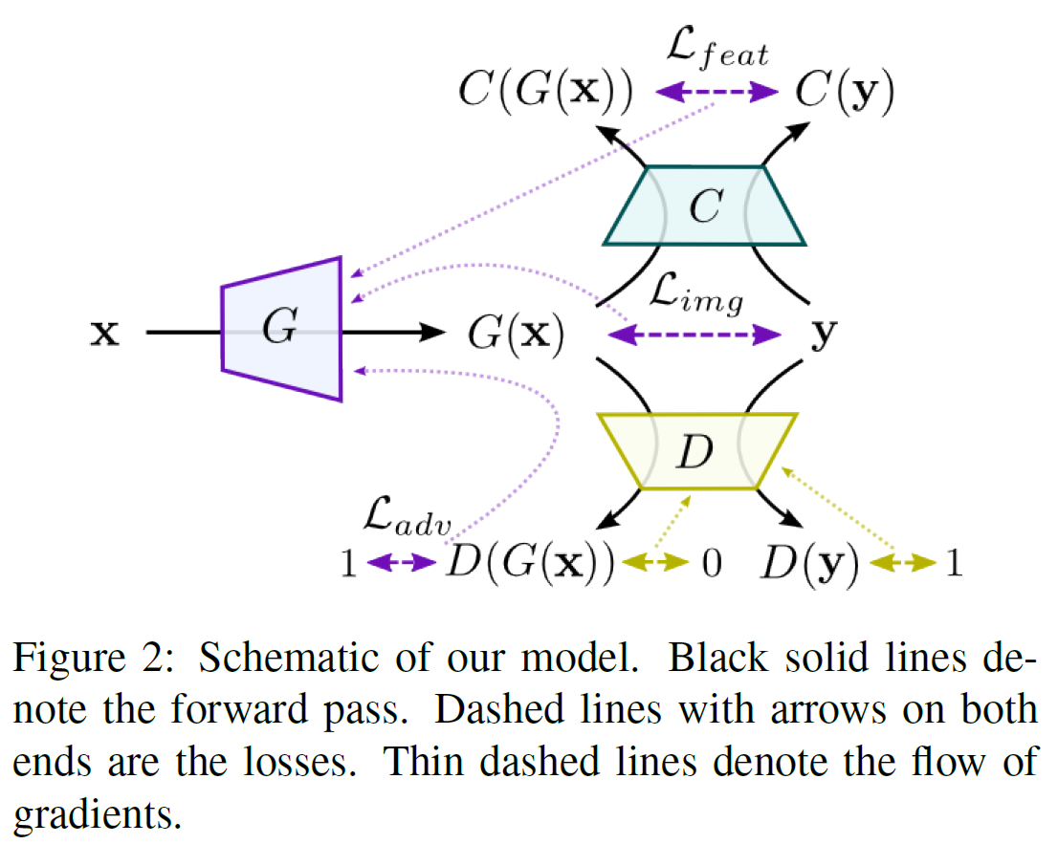
Approach

